Slide 1
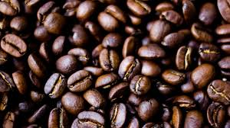


Welcome to WakeUp Café Project

Slide 2
Problem Statement
The locally developed, chain of coffee shops; WakeUp Café, has been experiencing fluctuating sales over the past year. Despite having a diverse menu and a loyal customer base, the management is unsure about the factors driving these sales variations. To make informed decisions about marketing, inventory, and staffing, they need a comprehensive analysis of their sales data. The goal is to identify trends & the locations–top/under generating revenue, best selling product in terms of quantity and revenue, and customer preferences to optimize operations and boost sales. The analysis should answer the following key questions:
What are the peak and off-peak sales periods (daily, weekly, monthly)?
Which products (coffee types, food items, etc.) are the bestsellers and which are underperforming?
Which are the top 3 performing store locations?

Slide 3
Recommended Analysis
How does the sale vary from hour of the day and day of the week?
Are there any peak times for the sales activity?
What is the total sales revenue for each month?
How do sales vary across different locations? – Which is the top 3
revenue generating store?
What is the average price per order per person?
Which products are best selling in terms of quantity and revenue?
How to sales vary by Product Category and Type?
Which products are sold most and least often?
Which product drives the most revenue?

Slide 4
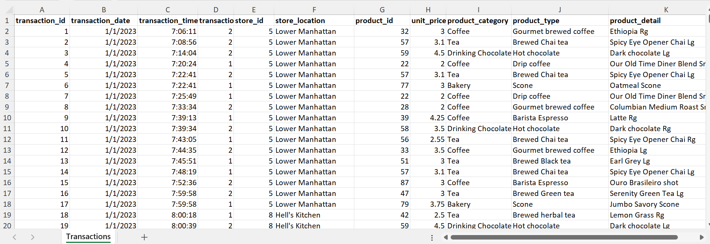
RAW DATA OF WakeUp Café

Slide 5
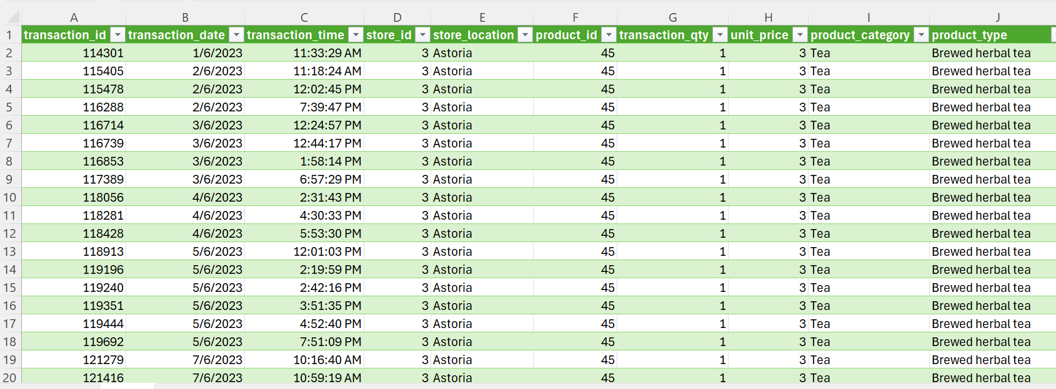
CLEANED & PROCESSED DATA OF WakeUp Café

Slide 6
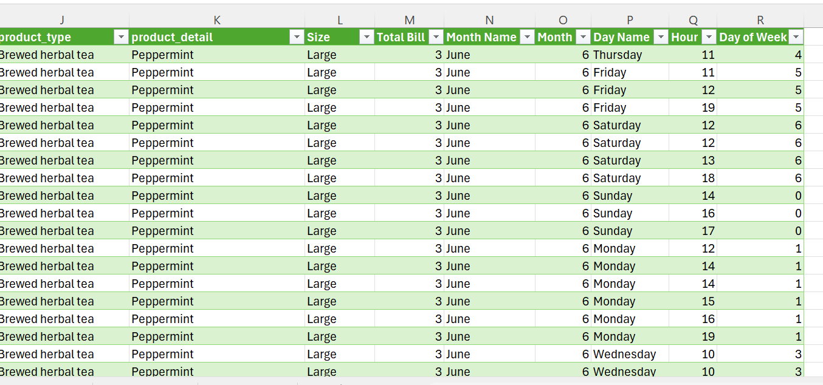
CLEANED & PROCESSED DATA OF WakeUp Café CONTD….

Slide 7
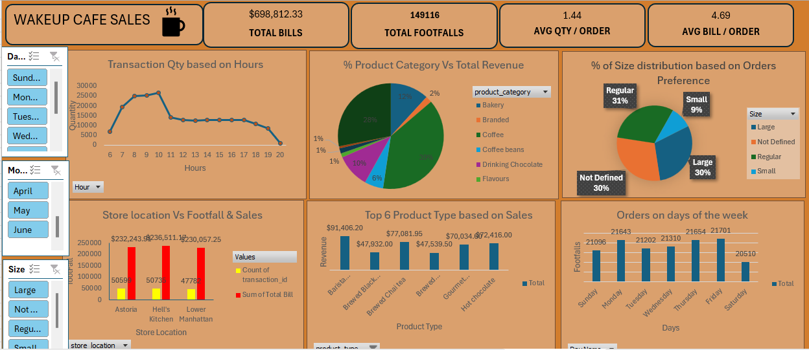
INTERACTIVE DASHBOARD SCREENSHOT

Slide 8
Conclusion Derived From The Analysis
1.Order receiving starts from 6am but maximum orders are received between 8am to 11am
ranging between 25000 to 26000.
2. Orders remain stagnant between 12 noon to 5pm and then slowly declines further ,lowest being at
8pm . Sales reaching its lowest at $880.
3. Categories generating maximum revenue in order of sales is Coffee, Tea, Bakery and Chocolate
Drink.
4. Least generating revenue is from ‘Flavours and Branded Categories of 1% and 2% respectively.
5. Sizes order for the drink between Regular and Large is almost similar of 31% and 30% respectively.
Small is only 9%.
6. There are large number of orders whose sizes have not been indicated.
7. Maximum orders are placed on Friday, Thursday, followed by Monday. Least orders received
in on Saturday.
8. Astiria, Hells’ Kitchen and Lower Manhattan are top 3 revenue generating stores.
9.Berista Expresso generates maximum revenue of about $91,406 & the least revenue generating product type is Brewed Herbal Tea of about $47,539.

Slide 9
Proposed Solution Based On The Analysis
1.Offer discounts during off peak periods to attract more customers.
2.Introduce point systems to increase the customer retention.
3. Give free samples from ‘Flavours and Branded Categories(least generating revenue) and get
quick customer review . Based on the survey make the appropriate changes in the flavours.
4. Introduce new flavours and quick bites during the peak period.
5. To boost Saturday’s sales, introduce 50% discounts on the second drink ordered. Introduce family
packages on drinks and snacks.
6. Since there are large number of orders whose sizes have not been indicated, introduce a system
where the order cannot go through unless the sizes of the cups are entered in the system.
7. Recommended to further analyse the reasons for low sales on some of the outlets and take
necessary actions to boost the revenue generation from those outlets.

Slide 10
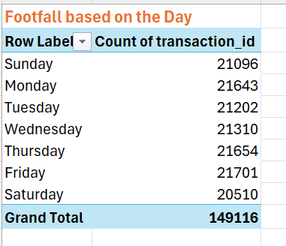
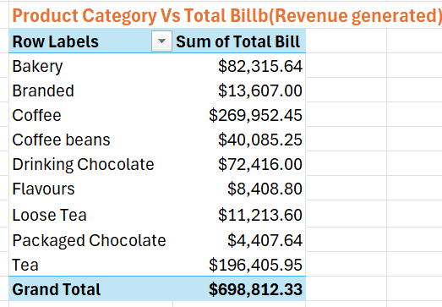
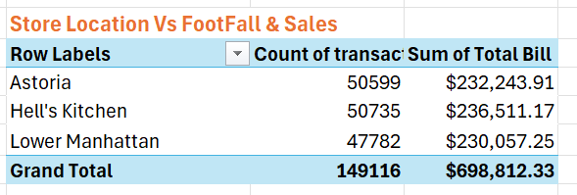
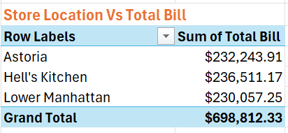
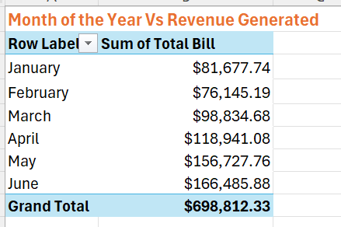
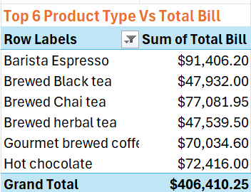
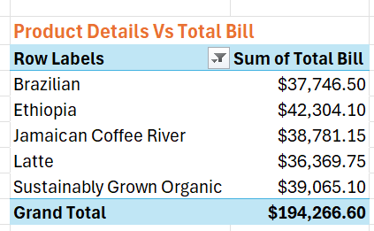
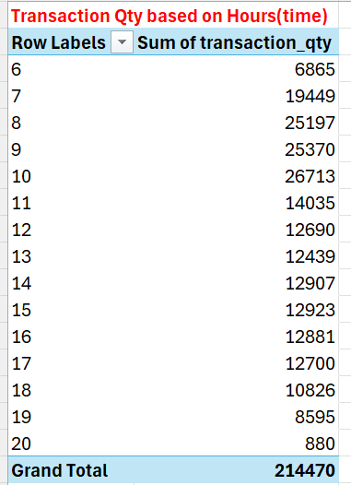
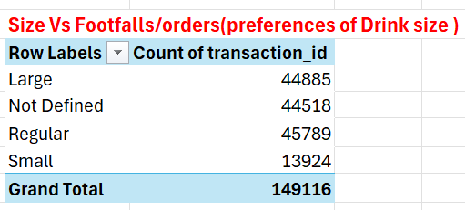

PIVOT TABLES SCREENSHOTS

